Slide 1

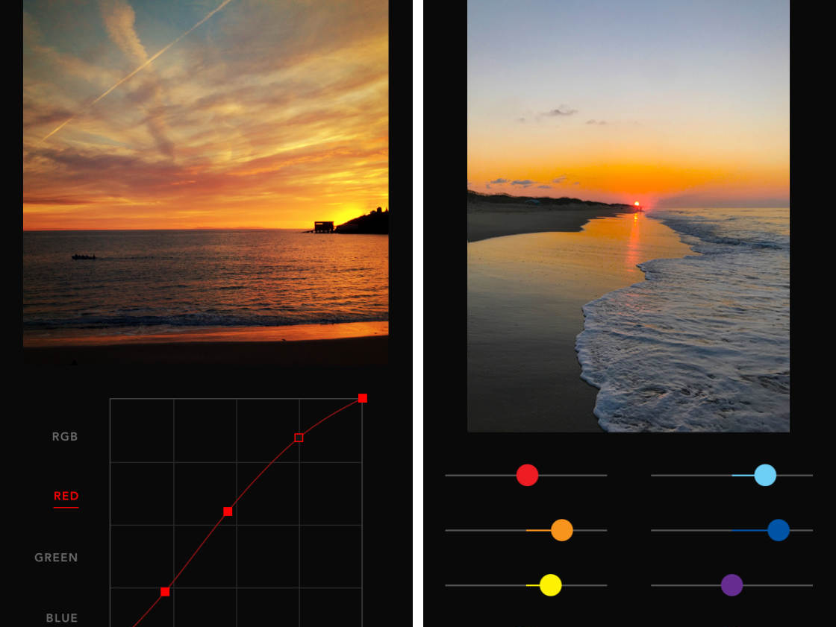
Live CAM Editor
Shaury Shobit
Priya Kumari

Slide 2

Topics
Introduction
Related work
Methodology
Results and Analysis
Conclusion
Future Scope

Slide 3

Introduction
Programming language Python.
Learning project.
It is combination of more than one idea.
Live Camera + Image Editor + Motion Sense + Auto Enhancements.
Light weight.
Handy and Powerful.

Slide 4

Related Work
"Interactive image editing using sliders" by Johnson et al. (2020)
"Real-time image editing applications in mobile devices" by Wang et al. (2022)
"OpenCV Image Histograms ( cv2.calcHist )" by Adrian Rosebrock

Slide 5
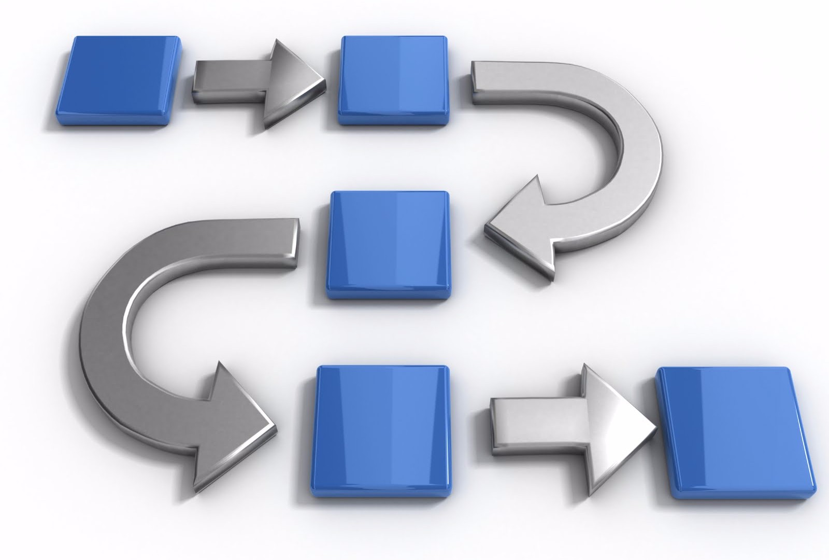
Methodology
Understand
Choose
Design & Implement
Test
Feedback
Collected related works.
Learn & understand the project modules & libraries.
Selection of correct libraries.
Started by breaking down the project.

Slide 6
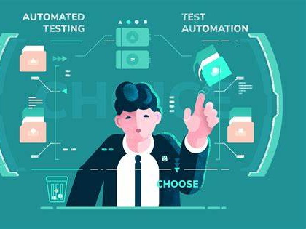
Contd.
3 modules:
Live camera Editor
Photo Editor
Motion Sensing Camera
Test & Analyze each modules.
Fixed the errors.

Slide 7

Working
•Color Conversions
•Histogram Normalization
•Auto Enhancing - CDF
•Hand Detection – Media pipe

Slide 8
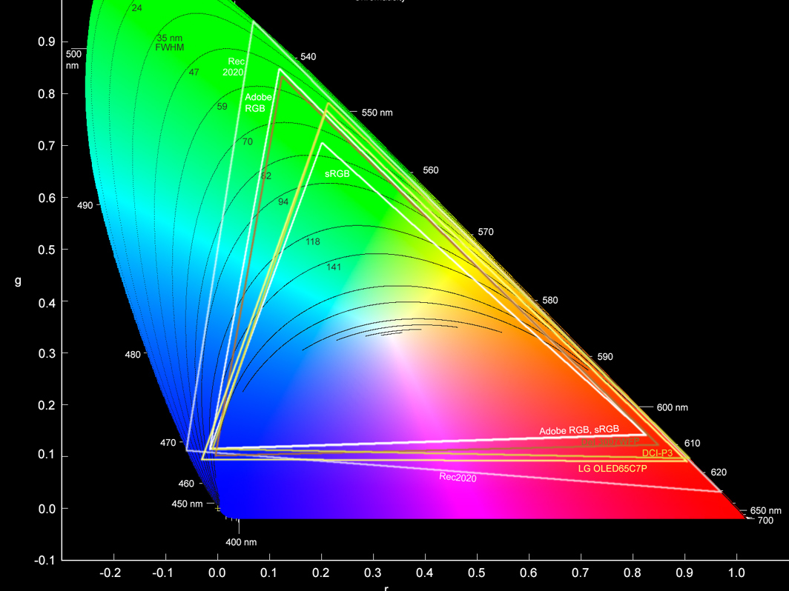
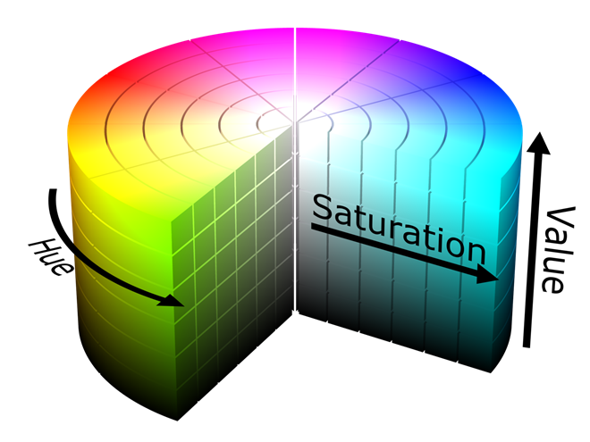
Color Conversions
•BGR to HSV Conversion
•Adjustments in HSV Color
Space
•HSV to BGR Conversion
•BGR to RGB Conversion for
GUI Display

Slide 9
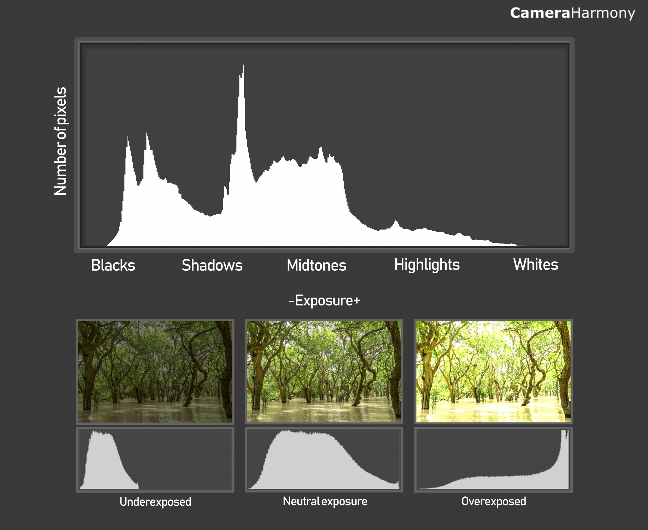
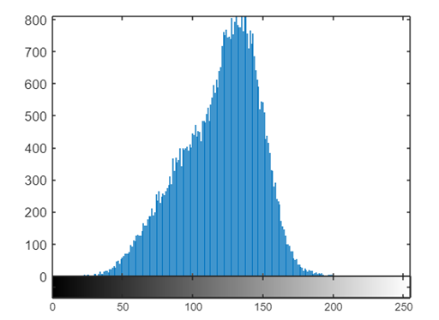
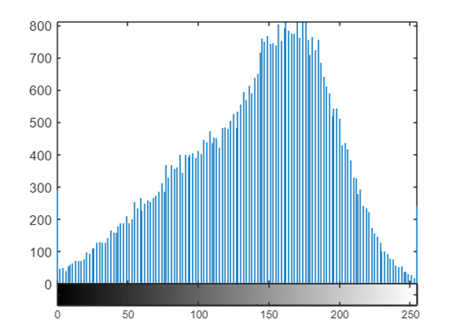
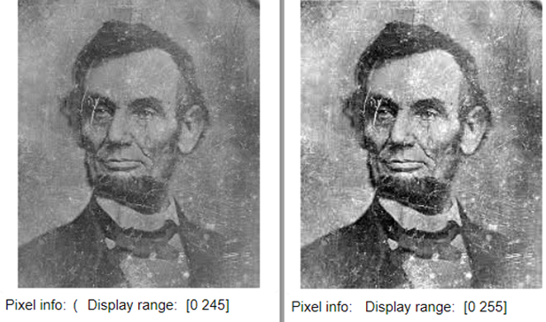
Histogram Normalization
Histogram normalization is a technique to distribute the frequencies of the histogram over a wider range than the current range

Slide 10
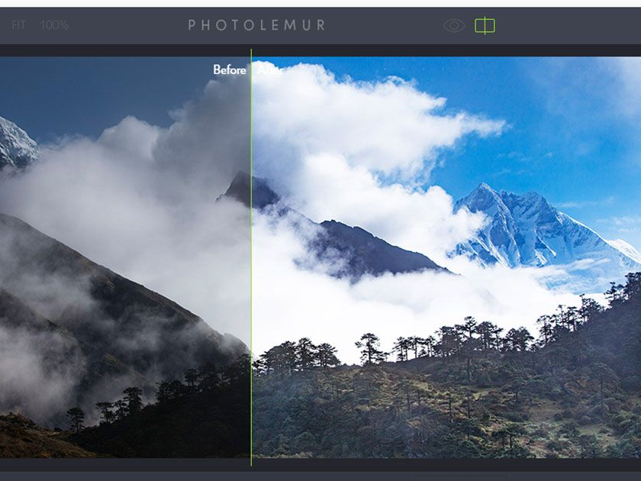
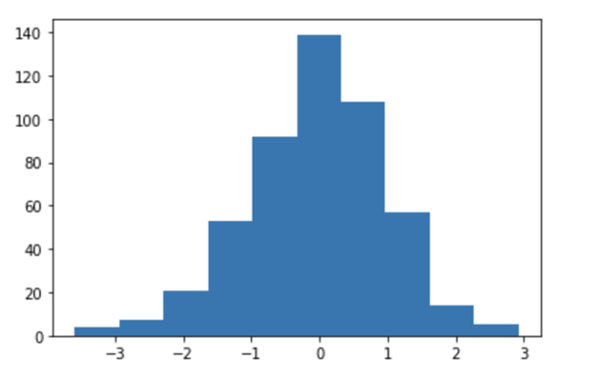
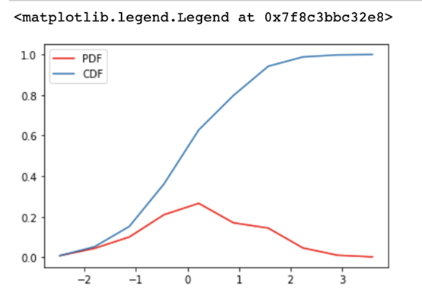
Auto Enhancing - CDF
The CDF is a useful tool for analyzing the pixel intensity distribution of an image.
It provides insights into the overall brightness and contrast characteristics of the image.

Slide 11
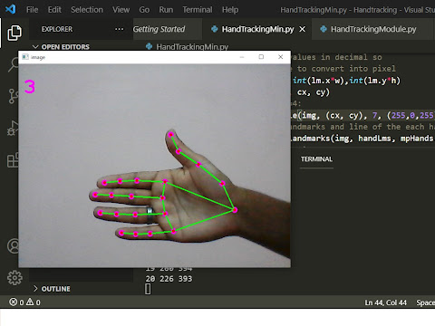

Hand Detection – Media pipe
The MediaPipe Hand Landmarker task lets you detect the landmarks of the hands in an image. These instructions show you how to use the Hand Landmarker with Python.

Slide 12

Results & Analysis
In each module we faced different issues.
Analyzing each part of code to make it simpler to understand and run efficiently.
Tested it at every stage.
Worked on our customer feedbacks.

Slide 13
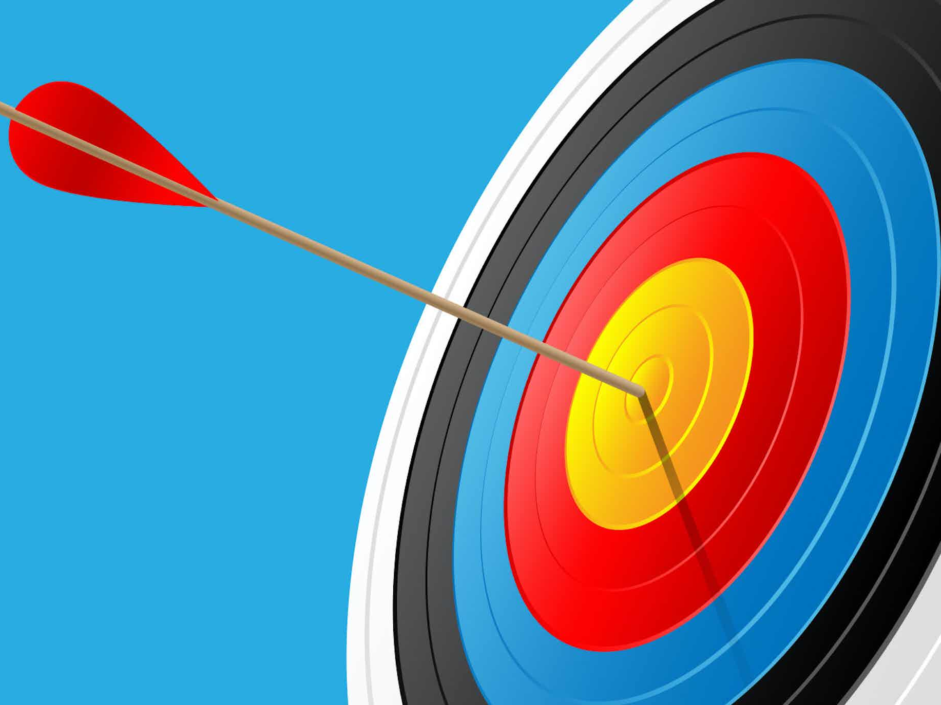
Conclusion
Covered our course.
This project was a fun and learn process.
Learn some new and useful stuff.
Working of Auto Enhancing and Detection of Hand was most amazing part.

Slide 14
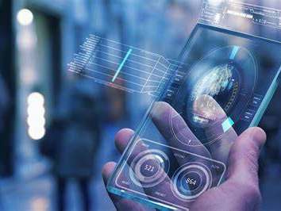
Future Scope
Improve UI.
Add more functionalities. - Filters, Adjustments
Improve algorithm calculations.
Record & Edit Videos
More accurate and Faster response.

Slide 15


